Slide 1

EDA of Hotel Booking Cancellations
Machine learning Task 1
By Ahmed Abdulrhman .
.Cellula- Technologies

Slide 2

Problem:
The cancellation rates of hotel reservations are high, resulting in revenue losses. Understanding what drives cancellations can help plan and forecast in a better way.
Dataset Details.
36,285 booking records.
17 columns (features).
No missing values.
Outliers were Solved.
EDA Objective.
To explore the patterns in the data and identify which features causes cancellation or lead to cancellation.
Machine learning Task 1

Slide 3
Question!
what do you think? Are most bookings canceled or completed? Take a Guess!
-Maybe factors like lead time, room type, or special requests play a role. Let’s analyze these features to find out!

Slide 4
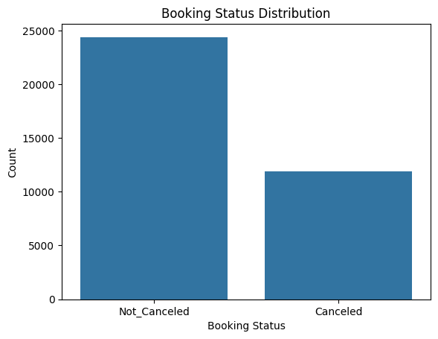
Analytics
-Most bookings are Not_Canceled about 25,000 compared to 12,500 canceled.
Not Canceled: ~68%
Canceled: ~32
-Now let’s look at how other features like lead time, special requests, and room type relate to cancellations

Slide 5
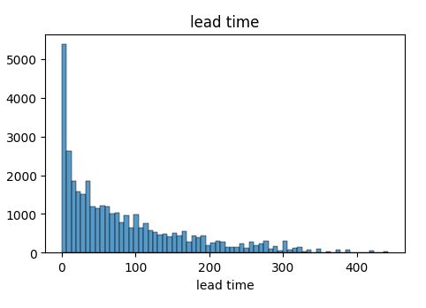
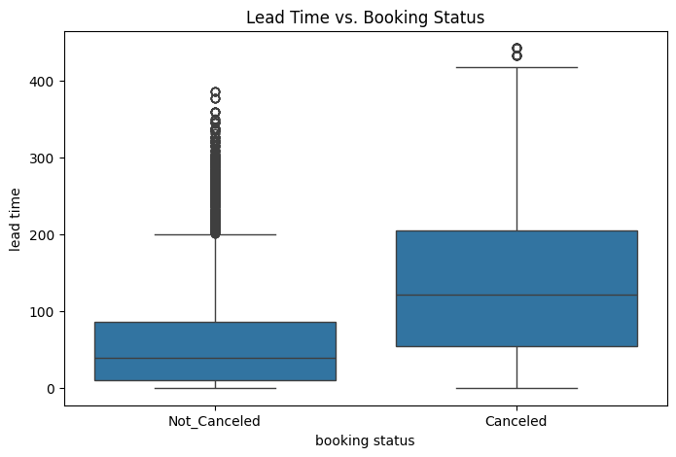
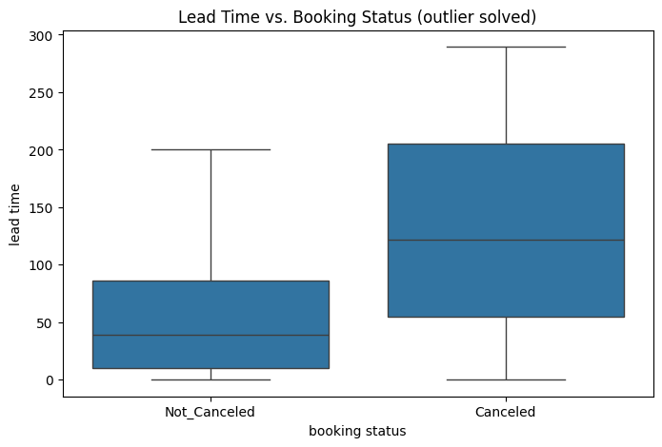
Lead Time vs Booking Status
Lead time is significantly higher for canceled bookings
Higher lead time may be linked to uncertainty or change of plans
Outliers are more in Not_Canceled.
Most bookings occur within 0-100 days lead time for Not_Canceled.
So, yes lead time has a noticeable impact on booking status.
Would lead time affect booking status? Let’s see!

Slide 6
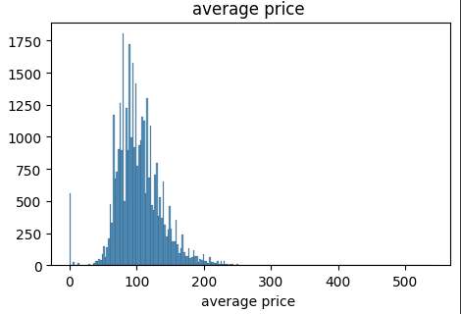
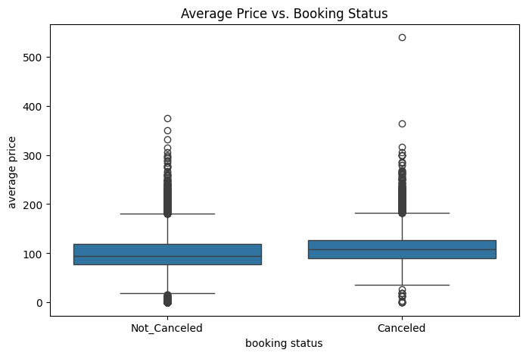
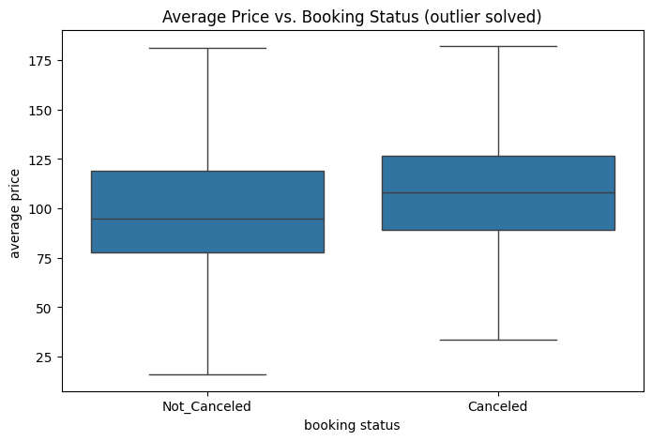
average price vs lead time
Both groups (Canceled & Not_Canceled) have similar price ranges overall
Median prices are slightly higher for canceled bookings.
Canceled bookings show more high-price outliers indicating some expensive bookings tend to get canceled.
Average price affects booking status, but its impact is secondary to other factors like lead time.
Do you think bookings with higher prices are more likely to be canceled? Let’s find out!.

Slide 7
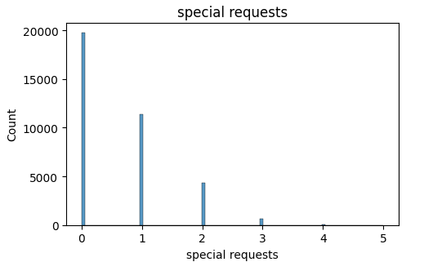
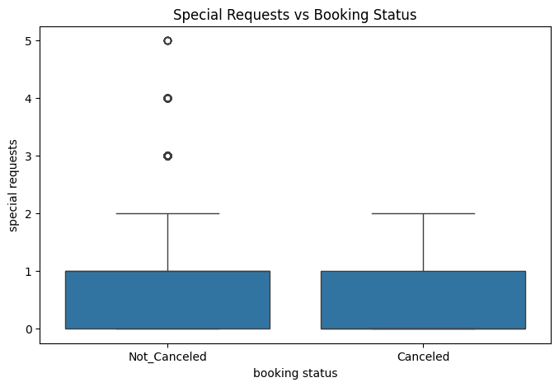
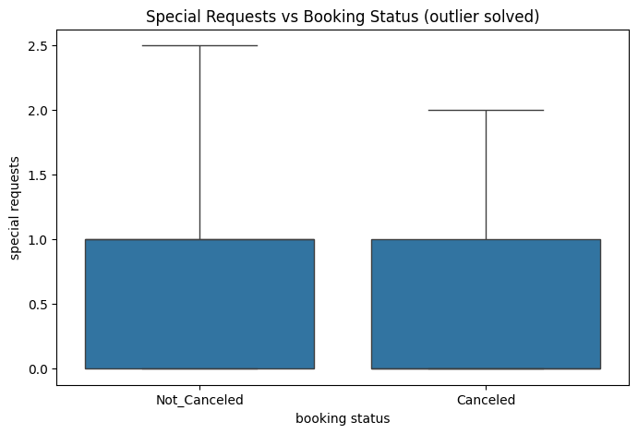
Special Requests vs Booking Status
Boxplot shows a wider range of Special requests for Not_Canceled bookings
Canceled bookings have fewer outliers possibly less engagement or early cancellation.
Presence of outliers indicates some guests make many special requests
So more requests are linked to lower cancellation.
Do you think guests who make special requests are more or less likely to cancel? Let’s see what the data says!

Slide 8
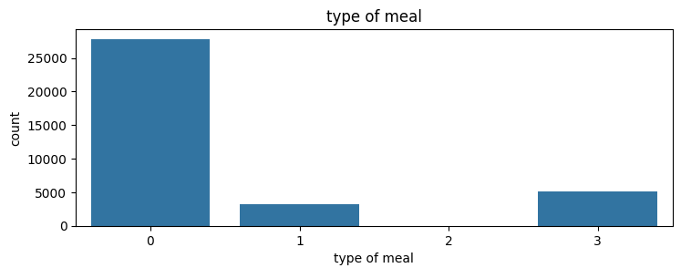
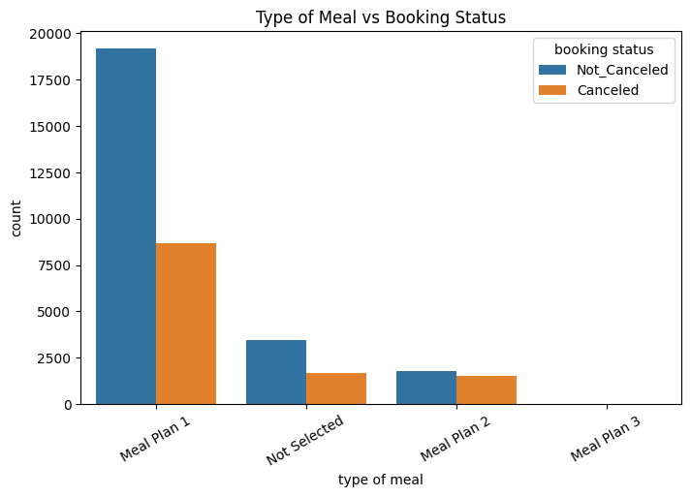
Type of Meal vs Booking Status
Meal plan 1 is the most common choice, showing the highest number of bookings (both Canceled and Not_Canceled ).
Meal plan 2 have significantly fewer bookings, but more Not_Canceled than Canceled.
Meal plan 3 is almost unused, indicating it’s either rarely offered or rarely chosen.
So the type of meal appears to have a weak to moderate impact on booking status
Could the type of meal plan affect whether a guest cancels? What do you think?

Slide 9
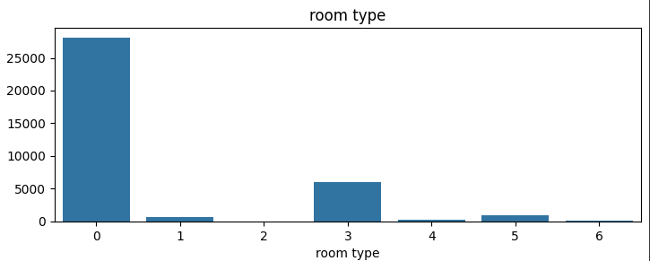
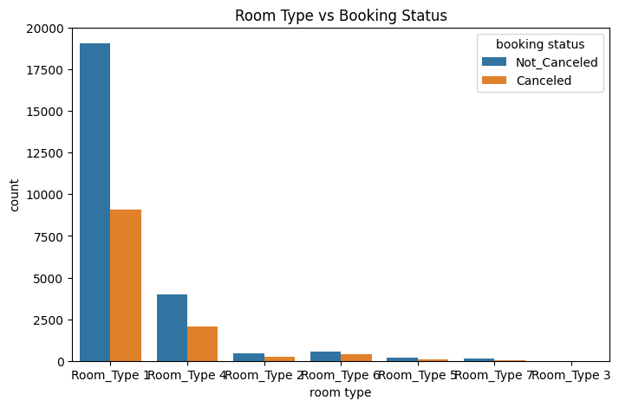
Room Type vs Booking Status
Room type 1 dominates in both canceled and not-canceled bookings.
Room type 4 has fewer cancellations indicating more serious or premium bookings.
Negative correlation with cancellation
so yes , room type is a predictor of cancellation premium or less common room types tend to have lower cancellation rates, suggesting more committed guests
Do guests cancel more often with certain room types? Let’s investigate!

Slide 10
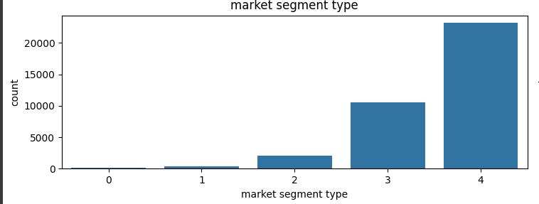
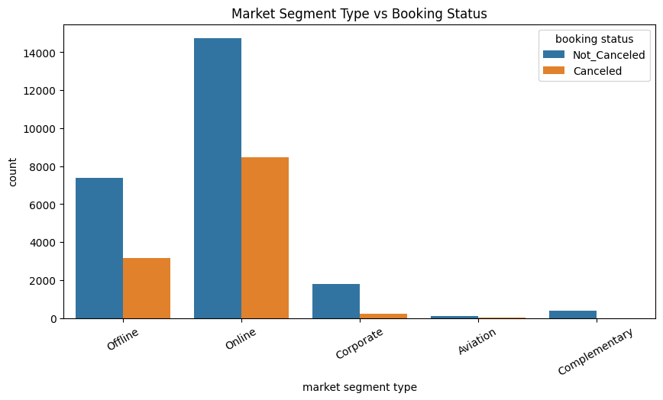
Market Segment Type vs Booking Status
Online bookings have the highest number of cancellations although also the most bookings overall
Offline and Corporate segments have fewer cancellations
Aviation and Complementary bookings are rare, but mostly not canceled.
So yes, market segment type affects cancellation online bookings have higher cancellation rates, while offline and corporate bookings are more reliable.
Do guests from certain booking channels cancel more? What’s your guess?

Slide 11
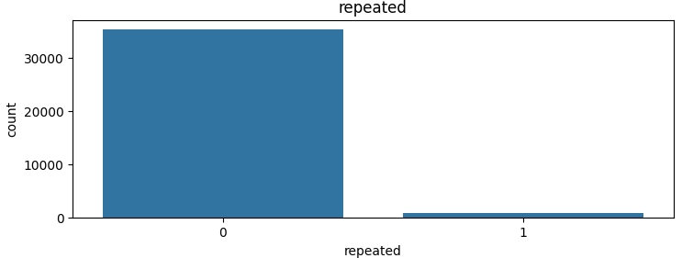
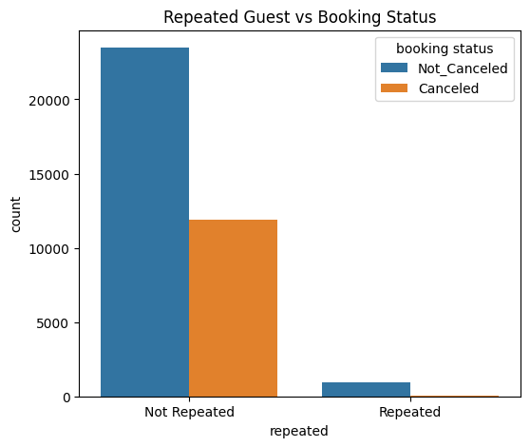
Repeated Guest vs Booking Status
Repeated guests are far less likely to cancel.
Cancellations are almost entirely from non-repeated guests
This makes repeat guest status a strong negative indicator for cancellation.
So yes, repeated guest status is a predictor of cancellation repeated guests cancel less often,
Do you think repeated guests cancel less often than first-time guests? Let’s check!

Slide 12
Conclusion: What Affects Cancellations the Most?
Lead Time – Longer lead times leads to higher cancellation rates. – Guests who book far in advance are more likely to change plans.
Repeated Guest – Repeated guests are unlikely to cancel. – Guest loyalty is a negative indicator of cancellation.
Market Segment – Online bookings show the highest cancellation rates. – Offline and corporate segments are more reliable.

Slide 13
THANK YOU
WOODGROVE BANK

